Slide 1
Moduelo
Dynamic simulation of landfills

Slide 2
General structure of the model
Initial data
Terrain
Meteorology
Waste
Operation
Elevations
Precipitation
Waste sources
Used materials
Properties
Humidity
Composition and properties
Filling order
Temperature
Evolution in time
Drainage systems
Calculations
Waste generation
Surface hydrology
Water flows inside the landfill
Biodegradation
Settlement
Storage, treatment and recirculation of leachate
Results
Waste streams
Landfill state
Leachate: flows and composition
Landfill gas: volume and composition
Settlement

Slide 3
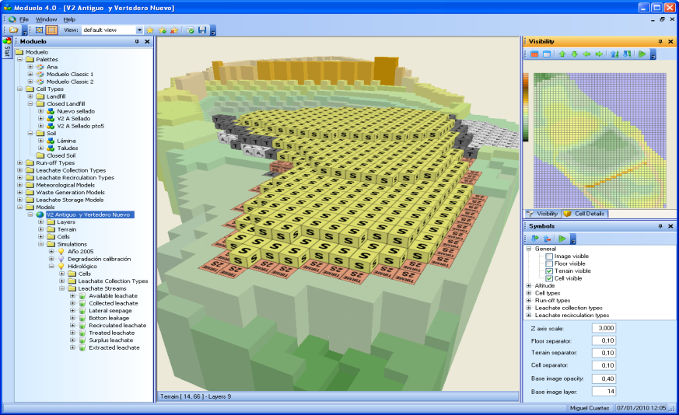
Aspects evaluated in the landfill
Development and operation
Pollution: leachate and landfill gas
Energy potential
Settlement
Aftercare requirements

Slide 4
Historical development
Moduelo 1 (1998)
Moduelo 2 (2003)
Moduelo 3 (2004)
Moduelo 4 (2008)
Environmental Agency of the Cantabria Government
Spanish Environmental Ministry (Project PNMA-PMICDIT 2000/032)
Companies
Local authorities
Other research groups
International Waste Working Group (IWWG) on Landfill Modelling

Slide 5
Current technological platform
Microsoft Windows operating systems
SQLServer 2008 R2 relational databases
Visual Studio 2010 development environment
.Net Framework 4.0 runtime platform
WPF based visual interface
Agile methodologies with unit testing
Altamira supercomputer ready

Slide 6
A walk through Moduelo

Slide 7
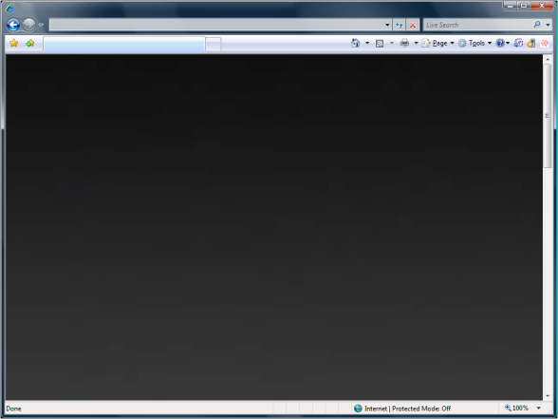
Application cases
Design
Planning
Diagnosis
Monitoring and control

Slide 8
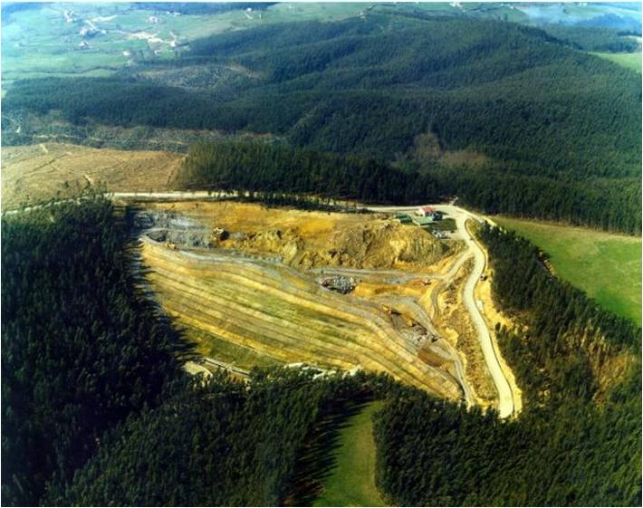
Application to landfill design
Objective: Design of a closure strategy to minimize the landfill aftercare period
  Classic closure with clay
  Closure with HDPE liner
  Leachate recirculation
Notes:
LANDFILL DESIGN
This was one of the first simulation exercises with MODUELO.
A simulation study was performed to assess different closure alternatives for an old landfill:
A classic closure with a certain thickness of clay
A final cover with plastic liner (HDPE)
Leachate recirculation after the closure
The objective of the study was to assess the impact of each alternative on the long-term landfill emissions.
A simulation model built in MODUELO and calibrated with field data was used with this aim. The alternatives were simulated during more than fifty years after the closure.

Slide 9
Application to landfill design
Notes:
The graph shows the simulation results obtained in each case with regard to the leachate COD load throughout the years.
The blue line represents the results of the “classic solution”: the clay layer reduces the natural infiltration but there is still a certain amount of water getting into the waste. This allows the organic matter to keep being broken down and dragged by leachate slowly.
If an ideally impermeable plastic cover was installed, liquid pollution would disappear soon after the closure (see the red line). However, after the years, the liner can degrade and let the water pass into the waste. In that moment, the water would re-start the breaking down of organic matter enclosed within the landfill, giving rise to an important pollution in a moment when all the leachate management system could have already been abandoned. In this situation the landfill pollutant “active” life would be extended as a consequence of this delay in the degradation processes.
Finally, the leachate recirculation (green line) would accelerate the degradation processes. It would provoke great pollution loads during the first after-closure years but it would allow abandoning the leachate treatment systems before, since the landfill stabilizes sooner.
More details in:
LOBO, A.; HERRERO, J.; MONTERO, O.; FANTELLI, M.; TEJERO, I. (2002). Modelling for Environmental Assessment of Municipal Solid Waste Landfills (Part 1: Hydrology). Waste Management and Research, Vol. 20, n. 2. pp. 198 – 210.
LOBO, A.; HERRERO, J.; MONTERO, O.; FANTELLI, M.; TEJERO, I. (2002). Modelling for Environmental Assessment of Municipal Solid Waste Landfills (Part 2: Biodegradation). Waste Management and Research, Vol. 20, n. 6. pp. 514 – 528.
LOBO A.; ESTEBAN A. L.; DOMÍNGUEZ B.; MUÑOZ J.; TEJERO I. (2001): Reducción de la vida de vertederos mediante biorrecuperación. RETEMA, Revista Técnica de Medio Ambiente. C&M Publicaciones. Vol. Nº81, pp. 57 – 67.

Slide 10
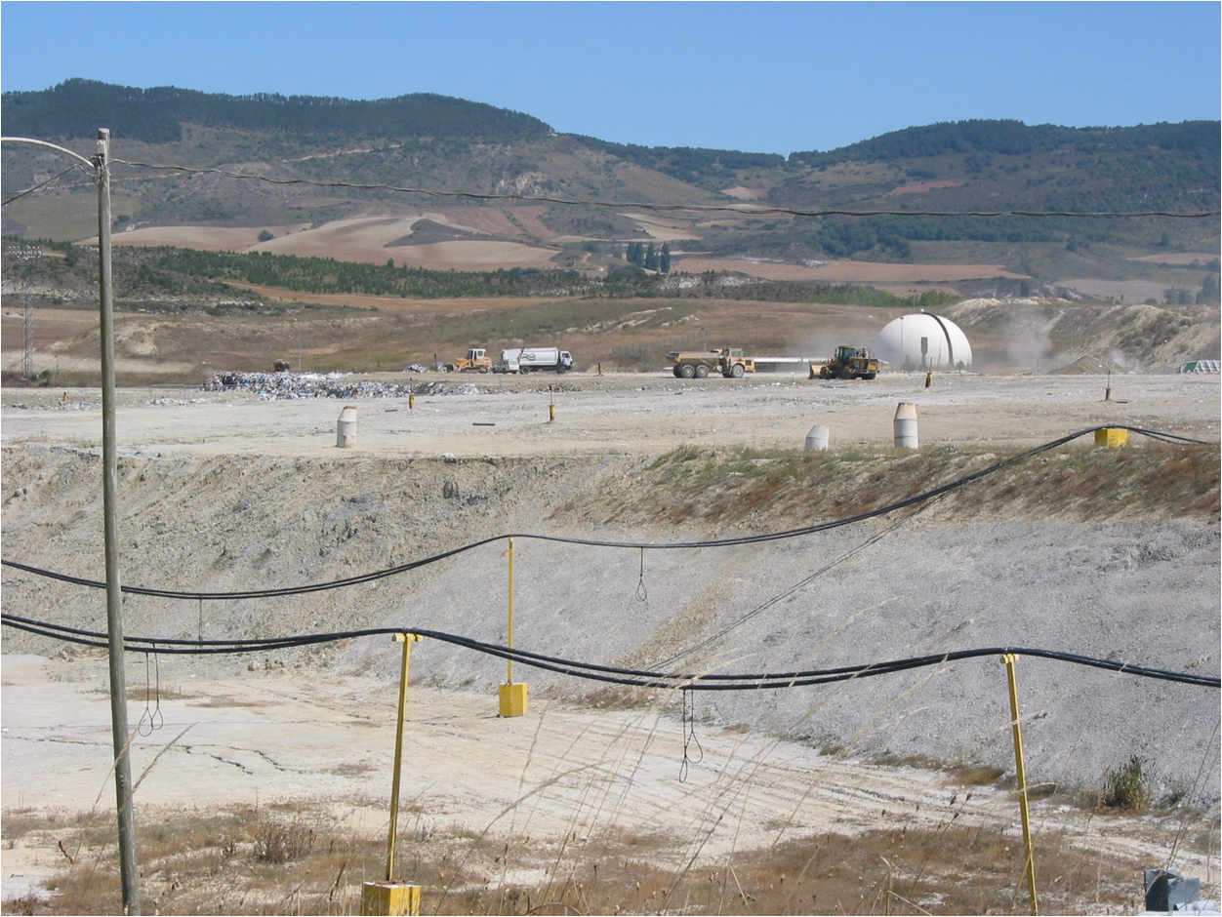
Application to landfill diagnosis
Objetive: explaining the irregularities found in the record of leachate flows
Notes:
LANDFILL DIAGNOSIS
In this case a simulation was applied to the hydrologic evaluation in detail of a landfill.
The operator company had observed a great dispersion both in the leachate flows and the quality parameters measured. On the other hand, the total leachate volumes evaluated on an annual basis were higher than expected, revealing an important amount of runoff and possibly water coming from other sources entering the collection system.
A detailed assessment of these sources contributing to the registered flows was required. With this objective several campaigns were planned, including geophysical measurements in the field as well as the modelization of the landfill basin with groundwater models (MODFLOW). The simulation of the landfill with MODUELO was a part of these studies.

Slide 11
Application to landfill diagnosis
Flows increased by the entrance of runoff coming from the surrounding hills
Notes:
During the calibration process, the minimum leachate flows were adjusted first. The simulation results could not explain the maximum registered flows, which suggested intermittent contributions of preferential flows to the collection system. New parameters were introduced in the model to take into account the part of the surface runoff that was being connected to the leachate collection pipes and an increase in the water available for infiltration.
The ulterior calibration process, based on the available leachate flow and quality data, allowed the detection and quantification of two sources increasing the flows reaching the leachate collection system: a small portion (6-7%) of the runoff over the landfill surface and the contribution of water coming from external hillsides of the same watershed, that represent a total surface area of around 20 Ha
In view of these results the internal runoff management system was improved and new perimeter trenches were built for the interception of external runoff, thus significantly reducing the leachate flows.
More details in:
LOBO, A.; TEJERO, I. (2007). Application of simulation models to the diagnosis of MSW landfills: an example. Waste Management, Vol.27, n. 5, pp. 691-703.

Slide 12
Application to waste management planning
Background: Planning of the waste management strategies in a region.
Objective: To analyze the impact of different waste management scenarios on the landfill leachate quality.
Notes:
WASTE MANAGEMENT PLANNING
The objective in this case was to evaluate the effect on a landfills of different waste management strategies in a region.
The leachate generated in the landfill of interest were being conducted to a municipal wastewater treatment plant nearby. To avoid disturbances in the wastewater biological process a limit of 1,000 mg/L was established in the discharge permit for the ammonia nitrogen concentration. Ammonia concentrations in the leachate used to vary under 90% of the limit by the time of the study.
New waste management strategies were being introduced in the region where the landfill is located, which included the construction of several new treatment plants and the closure of some of the four currently operating landfills. Until such time the new plants were built, several alternatives were considered to dispose of the municipal waste (MSW). Some of them weighed up the possibility of extending the capacity of the landfill of interest (the closure of which was initially planned for 2008), prolonging its useful life for five years and/or diverting other MSW streams (being taken to other landfill facilities during those days) to it during the following years. Four scenarios were considered for the landfill, each of which would have an impact on the leachate quality that could involve the change in the leachate management practices.
A simulation model was built in MODUELO to estimate the future evolution of the leachate quality under the different considered scenarios.

Slide 13
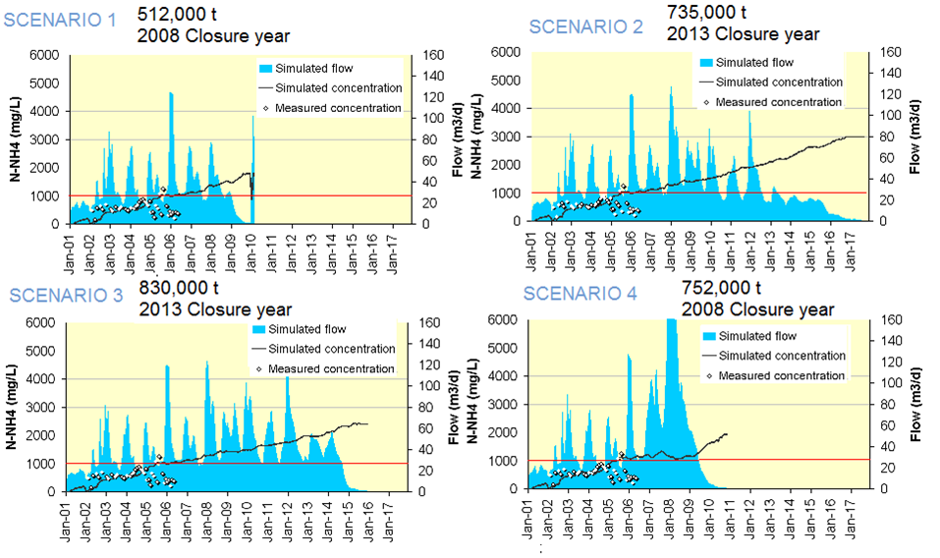
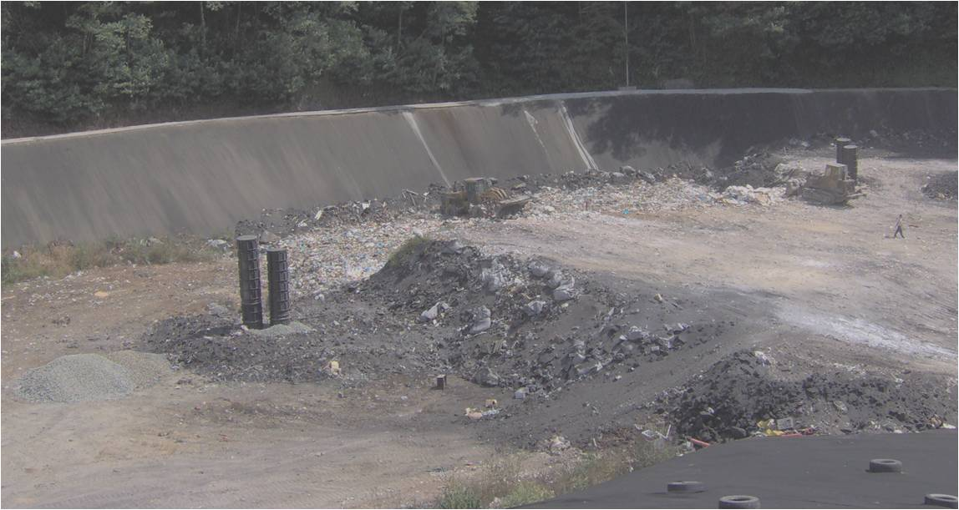
Waste management planning
Notes:
As a result of the simulations, estimates of the leachate flow along with its organic (COD and BOD) and ammonia concentration during the following years were obtained that allowed an assessment of the treatment needs in each situation.
The results showed how a raise in the amount of waste deposited in the landfill entailed greater flows of leachate (and consequently greater pollutant fluxes) even though ammonia concentrations did not undergo a significant increase. On the other hand, extending the operating life of the landfill involved not only greater volumes of leachate but also higher pollutant concentrations.
According to the simulations the concentration limit for ammonia in the permit would be exceeded (even doubled for the best case) in every scenario.
More details in:
LOBO, A.; LÓPEZ, A.; COBO, N. (2007). Mathematical simulations of a landfill within the assessment of municipal solid waste management alternatives. Proceedings of the “Sardinia 2007, 11th International Waste Management and Landfill Symposium CISA, Cagliari, Italy. ISBN 978-8862650038.

Slide 14
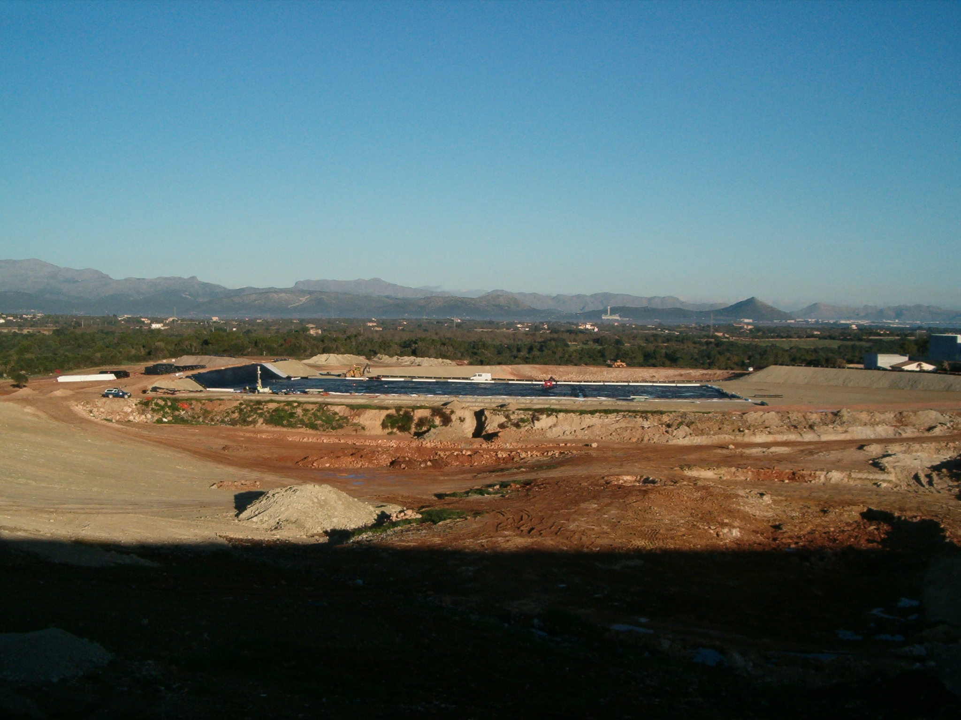
Application to monitoring
Background: a new landfill on top of an old dumping site.
Objective: To control the pollution generated by the new landfill and improve its operation.
Notes:
LANDFILL MONITORING
In this case the program is being applied as a part of a monitoring and control system of a landfill located on top of two old uncontrolled dumping sites.
The final objective of the Project is to control the pollution generated by the new landfill and to improve its operation.
A detailed monitoring program that includes in situ instrumentation has been designed for that, and a simulation model has been created that includes both landfills, thus permitting to consider the influence of the new landfill on the old waste.

Slide 15
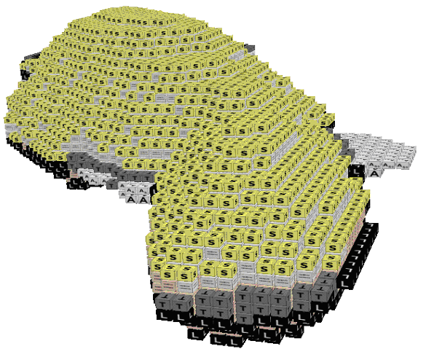
Application to monitoring
Notes:
The model allowed estimating the pollution potential of the old waste: the leachate generated by the old waste, the infiltration to the surrounding areas and the gas extraction needs. Regarding the new landfill, it has been used to estimate the leachate treatment and gas management needs or the current state of waste (moisture content, calorific power).
Currently it is kept updated and used as a monitoring tool, to contrast the environmental surveillance parameter values, and to perform the periodical hydrologic balance and other specific studies that come up during the landfill operation and management.
Parts of this case have been described in:
LOPEZ, A.; COBO, N.; CUARTAS, M.; LOBO, A. (2009). Estimating the future emissions of an old landfill by simulation. Proceedings of the “Sardinia 2009, 12th International Waste Management and Landfill Symposium. CISA, Cagliari, Italy. ISBN 978-88-6265-007-6.
LÓPEZ, A.; TEJERO, I.; CUARTAS, M.; LOBO, A. (2009). A case of simulation as a help for landfill management planning. Proceedings of the “3rd Hydro-Physico-Mechanics of Wastes”, Braunschweig (Germany), 10-13 March 2009.
COBO, N.; LÓPEZ, A.; LOBO, A. (2008). Characterization of an old landfill for potential degradability simulation. Proceedings of the “Global Waste Management Symposium 2008” Cooper Mountain, Colorado (EEUU), 7-10 September 2008.
LOBO, A.; COBO, N; LÓPEZ, A., CACHO, L. (2007). Advances in old landfills assessment. Landfill Research Trends. (ISBN: 1-60021-776-1) Nova Science Publishers, Inc. New York. Chapter 6, pp. 167-189.
15

Slide 16
Moduelo 4.0
© 2012 GIA UC - Rainsoft
moduelo@unican.es

